Slide 1
Argumentation and Explanation in Science
Martin Palermo
NYSMT
Notes:
Welcome to this professional development piece on…...

Slide 2
Objective:
identify and differentiate between the practices of scientific explanations and arguments

Slide 3
Why?
The New York State Science Science Learning Standards (NYSSLS) based on the NGSS and NRC’s framework have been adopted by New York State which includes these practices of science.
Are you ready to engage with these practices in your classroom?

Slide 4
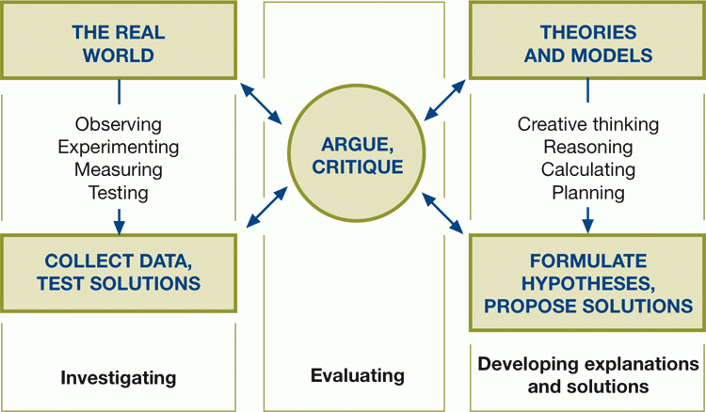
Argumentation and Explanation in the Framework

Slide 5
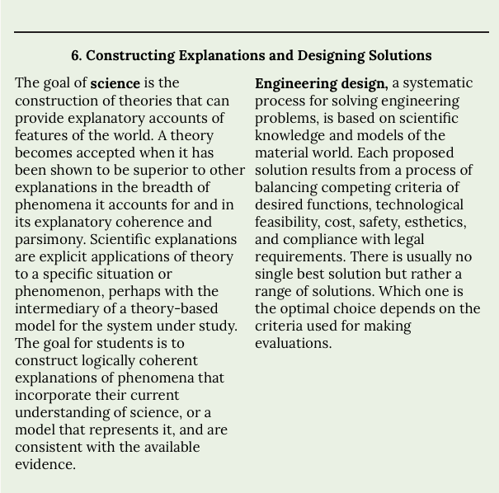
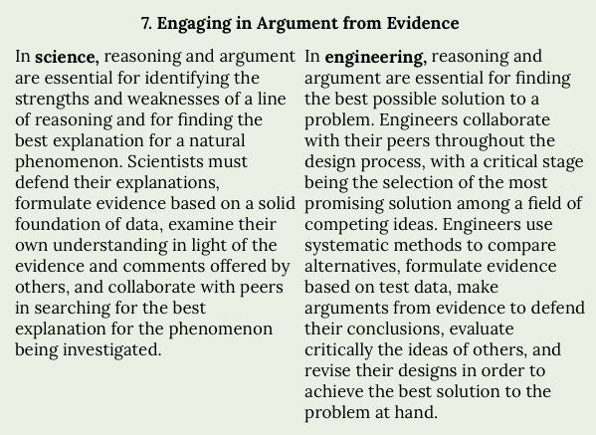
Why should we differentiate between argumentation and explanation?
The NYSSLS/NGSS framework expects students to engage in these two DISTINCT scientific practices of ‘argument from evidence and ‘constructing explanations.’ along with 6 additional practices.

Slide 6
We Use Argumentation and Explanation in Scientific Inquiry

Slide 7
What is the purpose of scientific inquiry
Provide knowledge and understanding of the world.
We create knowledge by providing evidence for our views; i.e., by constructing arguments. We create understanding by discovering the causal structure of the world; i.e., by constructing explanations.
Argument and explanation make equally important contributions to inquiry but educators typically only focus on the explanation piece in classrooms

Slide 8
Why should we differentiate between argumentation and explanation?
The conditions that make something a good explanation differ from the conditions for being a valid argument.
The goal of an explanation is not to persuade but to generate an increased understanding or knowledge
The goal of an argument is to justify a claim to knowledge

Slide 9
Explanation

Slide 10
Explanations
An explanation should make sense of a phenomenon or a feature using scientific facts
In an explanation, there is no doubt about the phenomenon or that a specific characteristic or event occurred so there is no need to establish its validity with evidence.
Example: Why is grass green?

Slide 11
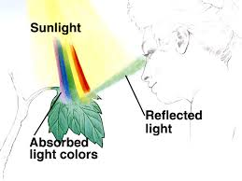
An explanation consists of 2 parts:
What is being explained: “the grass is green”
The facts that make up the explanation: (in the grass example, this is the notion that most species of grass produce chlorophyll which absorbs blue and red light well but mostly reflects green light which accounts for the lawn’s green color).

Slide 12
A characteristic of an explanation is that the facts making up the explanation are less certain than what is being explained, which is derived from observation, laws or theories that are generally accepted.
What is being explained:
Why is the grass green?
The facts that make up the explanation:
Most species of grass produce chlorophyll…...

Slide 13
Argumentation

Slide 14
Scientific Argument
An argument is a claim that justifies a belief using data and reasoning.
There is a substantial degree of tentativeness in an argument (this is the reason for having the argument)
An argument uses evidence and reasoning to determine which of the ideas about the natural world is best

Slide 15
What types of things can we argue about?
Explanations
Observations
Causes
Models
Etc.

Slide 16
Example of a scientific argument
Argument: In the 1800’s, high maternal mortality rates in clinics are caused by the “dirty hands” of doctors.
Upon research by Ignaz Philipp Semmelweis, he found that mortality rates from childbed disease were extremely low for street births as opposed to those done in clinics. He concluded that the illness was coming from direct and indirect contact with cadaverous vapors being spread by doctors and midwives not washing their hands before delivery. When he instituted a clinic wide policy of hand washing maternal death rates plummeted from 1 in 10 to 1 in 100 forming a strong argument in support of his claim.

Slide 17
Argumentation using Claim, Evidence, Reasoning (CER)

Slide 18
A claim
A statement based upon something that is believed to be true

Slide 19
Evidence
Data that is collected that supports the claim

Slide 20
Reasoning
Justification linking the evidence to the claim showing why the evidence supports the claim, using scientific principles.

Slide 21
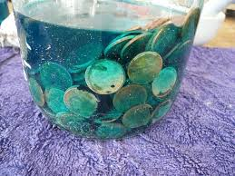
Example of an student argument using CER
A student observes the following:

Slide 22
Student Claim:
A chemical reaction has occurred

Slide 23
Student Evidence:
The penny was brown in color, did not dissolve in water and its density was 8.90g/cm³. The color, solubility and density changed.

Slide 24
Student Justification
Color, solubility and density are all properties. Since the properties changed, I know a new substance was made, which means a chemical reaction occurred. Chemical reactions create new substances that have different properties from the old substances.

Slide 25
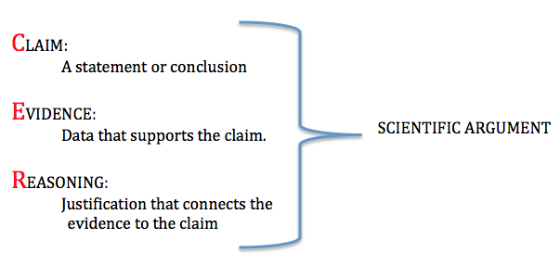

Slide 26
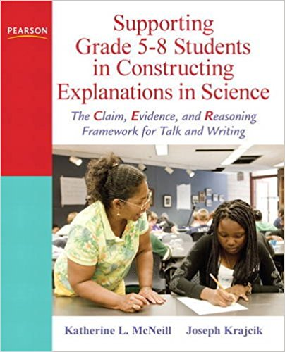
Problems with the Current Material...
Much of focus for authentic science materials related to NGSS have been on CER. Unfortunately, they have been mislabeled as Explanations when in fact they are Arguments.

Slide 27
Why would we approach scientific inquiry from two different vantage points?
This depends on the epistemic aims of the scientific inquiry
Are you trying to provide evidence for your views? Argument
Are you trying to create understanding? Explanation

Slide 28
Example of a scientific argument and explanation around the same phenomenon based upon two different epistemic aims of inquiry.

Slide 29
Phenomenon: The air pressure in my car tires decreases in the winter
AIM of this inquiry: Justify the belief that gas pressure is directly related to temperature
Argument:
Claim: As the temperature of a gas decreases so does the pressure without the loss of any air from the tire
Evidence: When a closed flexible container (like a tire) is cooled, the pressure decreases.
Reasoning: Since the container is sealed no air is escaping so temperature and pressure must be directly related; as temperature decreases so does gas pressure resulting in the tire deflating in cold temperatures.

Slide 30
Phenomenon: The air pressure in my car tires decreases in the winter
AIM of this inquiry: Understand why a decrease in temperature causes the gas pressure to decrease
Explanation: When temperature decreases, there is a decrease in the Avg. kinetic energy of the gas particles causing them to move slower. If they move slower, the particles will exert less force on the container each time they hit the walls, which leads to a decrease in gas pressure. Since the walls of the container are flexible, it will contract until the pressure of the gas once more balances the pressure of the atmosphere. The volume of the gas therefore decreases as the temperature of the gas decreases.

Slide 31
Example where the phenomenon is not in question but the cause of it is

Slide 32
Phenomenon: The Earth’s temperature is increasing
The fact that global warming exists is not in question but the cause of the increase is.
Argument: Global warming is increased by human activity
Explanation: How CO₂ influences global warming

Slide 33
Differentiating Argument from Explanation
The best way to remember the difference is to think of them as answering two different questions:
An argument answers the question: How do you know? (This is a request for evidence)
An explanation answers the question: Why is that so? (This request for cause)

Slide 34
Arguments
Explanations
Justify a claim to knowledge
Use evidence/data in support of claim
Equally important scientific practices
Rely on scientific principles
Contribute to scientific inquiry
Provide understanding of a phenomenon
Generate knowledge

Slide 35
Resources
Click on the embedded links in the video for more information on the practices of argumentation and explanation
If you would like a copy of the slides in this presentation click on the link at the end of the video

